Slide 1
Challenges to Adopting Stronger Consistency at Scale
陈志遥
April 19, 2019

Slide 2
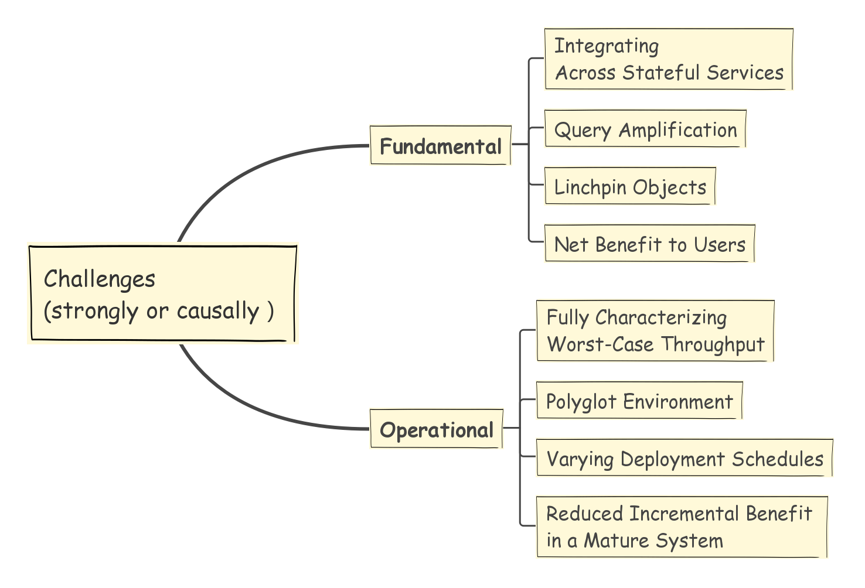
“Our hope is that these barriers can be overcome. ”
-- Phillipe Ajoux
March 30, 2015

Slide 3
Contents
1
Introduction of Facebook
2
Fundamental Challenges
3
Operational Challenges

Slide 4
目录 Contents
1
Introduction of Facebook
2
Fundamental Challenges
3
Operational Challenges

Slide 5
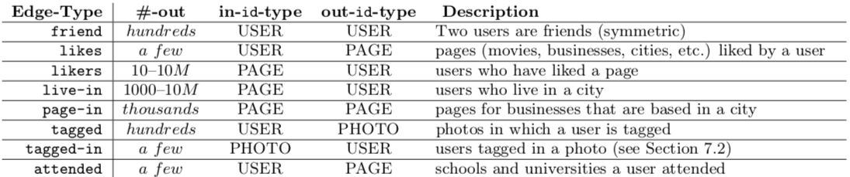
Introduction of Facebook
Social Graph
nodes（Object）People or things(i.e. user, page)
edges（Association） symmetric/unsymmetric relationship between two nodes(i. e. friend, likes/likers)

Slide 6
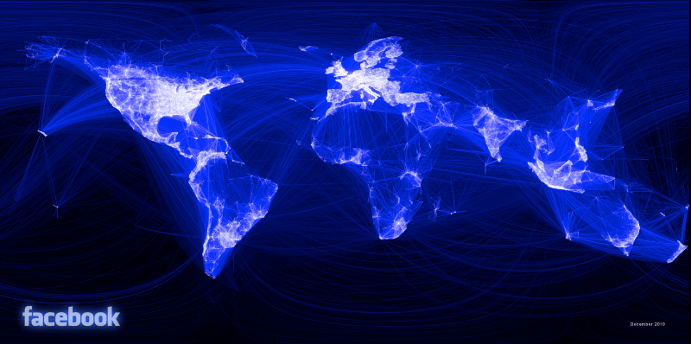
Introduction of Facebook
Social Graph (database)
typical node : less than 1 thousand edges
most popular pages and applications: tens of millions of edges, but is only a tiny fraction of the whole graph

Slide 7
Introduction of Facebook
Data:
Sharding
Geo-replicated data stores
Tightly integrated caching systems
Notes:
对于这么复杂的海量数据，FB通过以下机制来存储和使用：

Slide 8
Introduction of Facebook
Example: adding a node/edge
written to a single MySQL instance
asynchronously replicated to all data centers
updated or invalidated in multiple layers of cache
delivered through a scalable pub-sub system to other service
i.e. News Feed
Notes:
1.被写入一个单一的MySQL实例中
2.被异步地被复制到所有数据中心中
3.在多级缓存中被update或invalidate
4.被投递到其他可扩展的发布-订阅系统中（如News Feed）

Slide 9
Introduction of Facebook
Recent researches:
scalable causal consistency
Chainreaction: a causal+ consistent datastore based on chain replication. In EuroSys, 2013
Bolton causal consistency. In SIGMOD, 2013
strong consistency
Spanner: Google's globally distributed database. In OSDI, Oct. 2012.
HyperKV: A dis tributed, searchable key-value store for cloud computing. In SIGCOMM, 2012.
transactions
Scalable atomic visibility with ramp transactions. In SIGMOD, 2014.
Granola: low-overhead dis- tributed transaction coordination. In USENIX ATC, June 2012.
Notes:
如今针对各种一致性模型都有很多研究成果，但是FB都没有用到

Slide 10
Introduction of Facebook
Have not adopted yet.
Why not?
Notes:
如今针对各种一致性模型都有很多研究成果，但是FB都没有用到

Slide 11
目录 Contents
1
Introduction of Facebook
2
Fundamental Challenges
3
Operational Challenges

Slide 12
1.Integrating Across Stateful Services
Heterogeneous(异质的) services
TAO：multitenancy(多租户) and hierarchical caching – high query rate
Unicorn：document sharding and a leaf-aggregator model – wide range query
……
while most consistency research designs assume monolithic(单一的) service.
Notes:
最重要的问题就是：如何将多种状态性的服务整合起来。
没有哪种单一的数据存储机制能够有效地在高度分片的系统中应对各种载荷（高并发、大范围等），所以很多service都选择自己专用的分片功能来维护自己的数据存储、缓存和索引。
TAO：处理对Social graph的高并发查询
Unicorn：处理对Social graph的大规模查询

Slide 13
1.Integrating Across Stateful Services
1.1 Storing Data Consistently Across Services
same data lives in different services
strong consistency: synchronously propagate update notifications => latency
causal consistency: avoid atomic, but dependency complex when integrating & communicating.
Notes:
这个问题主要有三个方面的困难：第一个是数据存储
Strong：影响可用性和延迟
Casual：使得依赖图变得复杂

Slide 14
1.Integrating Across Stateful Services
1.2 Decentralized Access to Services
parallelism and pipelining of WebPage/APP
i.e. notification bar & central content
So user’s device have to define guarantees/isolations
Notes:
通过并行的分散请求来分别获得通知栏和中间的内容数据，再在客户端中merge。
由于是并发请求，所以必须在用户的设备上实现对于强一致性的保证。

Slide 15
1.Integrating Across Stateful Services
1.3 Composing Results
for range scans / complex queries
Get : list of users Likes something
Coordination mechanism needs dependencies of queries, rather than data that result
Hard to track & capture dependencies.
Notes:
对结果进行组合的协调机制需要这些查询结果的依赖关系，而不是数据结果本身。
协调机制很难对复杂系统中的这么多依赖关系进行获取和追踪

Slide 16
2.Query Amplification
Single request => thousands of sub-queries => more…
Slowdown Cascades
Different sharding and indexing schemes => Ordering dependenies
weak consistency: one slow node does NOT affect whole system
strong consistency: failure in one shard of one service would propagate to all shards of downstream services.
Latency Outliers
Wait the slowest query to join the result
Notes:
一个请求会被放大成上千个子查询，每一个子查询也可能继续被放大
第一个方面：对于同样的数据，不同的服务采用不同的分片和索引机制,由此会带来不同服务的分片之间的排序依赖性。
弱一致性时，慢的节点尽管抛出了不一致性问题，但是他不会影响整个系统；强一致性的话一个节点的某个分片会影响下游服务的所有分片，也就是说 一个节点变慢，由于查询放大，会波及到其他节点
另一个方面：对于用户来说，在强一致性中用户必须的等待最慢的那个查询结果的返回，然后将结果join在一起。

Slide 17
3. Linchpin Objects
High read/write rate
i.e. popular users, popular locations
Must provide good performance to them
query amplification => user latency amplification
Notes:
就是 如何对网红对象提供很好的读写性能

Slide 18
4.Net Benefit to Users
Strong consistency is good for programmers
BUT does it worth?
i.e. one anomalous result in one million queries
worse user experience
Notes:
如果乐观点：一百万个查询里面只出现了一个数据不一致的结果，那么我们没必要费精力、牺牲查询速度来解决它。
程序员是爽了，但是强一致性带来的额外的通信和耦合需要更强的分布式特性，这会增加延迟、降低可用性,使得用户体验很差

Slide 19
目录 Contents
1
Introduction of Facebook
2
Fundamental Challenges
3
Operational Challenges

Slide 20
1.Characterizing Worst-Case Throughput
Different services infrastructure design for different error condition
i.e. discard work after failure
i.e. design HA for worst-case conditions
……
Hard to fully characterize failure and recovery behavior
Difficult to find ahead of time / to identify when it is occurring
Notes:
“如何鉴别最差的情况”
不同的服务会根据需求来设计应对特殊情况的机制。
有些系统在failure后直接丢弃一些事务；有些系统会对积压事务执行机会性批处理来保证吞吐量；有些系统是专门为最坏情况设计的高可用……
在一个复杂系统中，很难充分鉴别系统的failure和recovery行为，
所以！就很难通过枚举的方式针对所有特殊情况制定应对机制。

Slide 21
2. Polyglot Environment
predominant：C++
Thrift supports：Python, Java, Haskell, D, Ruby and Go
application code：Hack and PHP
……
Must provide interfaces to languages to access strong consistency platform
Different thread models are idiomatic for different languages
Notes:
Thrift：一个可扩展的跨语言的开发框架，用来开发service的。
必须对这些不同的语言提供访问一致性平台的接口，同时不同语言对应不同的强一致性thread model
所以这也是实际开发过程中会遇到的挑战

Slide 22
3. Varying Deployment Schedules
Stateless application: aggressive
stateful and mature low-level services: conservative
Deployment velocity of inter-service coordination mechanism ⬇️
Practical difficulty and software engineering risk ⬆️
Notes:
跨服务的一致性协调机制 的发布速度 会受到最慢的服务发布速度的影响。
然后一低一高

Slide 23
4. Reduced Incremental Benefit in Mature System
Many workarounds already in place in mature systems
i.e. bypass cache and read directly from a single authoritative database
i.e. application-level schema
……
These workarounds reduce the incremental benefits of deploying a generic system for stronger consistency guarantees
Notes:
尽管作者说这些workaround不会在新的系统里面出现，
但是这些workaround在成熟的系统里面带来的好处使得人们不愿意放弃现有的系统，去从头开发一个具有强一致性的更好用的系统。

Slide 24
Conclusion

Slide 25
谢谢！

